Slide 1
SALES DATASET ANALYSIS – ADVANCED EXCEL PROJECT
Presented By
Payaswitha Harshini Kareti
Date: 03-09-2025
Course: DA & DS
Batch Name: July Batch

Slide 2
Project Overview & Objectives
Objective: To analyze sales data to identify trends, evaluate sales performance, and provide actionable insights for improving business decisions
Goals:
Analyze sales trends over time (monthly, quarterly, yearly).
Identify high-performing products, categories, and sales channels.
Assess the impact of discounts on overall revenue and profitability.
Build an interactive dashboard to support quick and informed decision-making.

Slide 3
Data Description & Preparation
Dataset contained 9,995 transaction records across the years: 2014, 2015, 2016, & 2017
It contained 21 columns, a few of the key fields are: Order Date, Ship Mode, Customer Segment, Category, Sales, Discount, and Profit
Data Cleaning Process:
Removed duplicates and invalid entries
Standardized data type formats for the columns: Sales (Number), Order Date (Date), Ship Date (Date), Discount (Percentage), Profit (Number)
Added column: “Adjusted Sales” = (Sales × (1 – Discount))
Validated that ‘Discount’ and ‘Sales’ values are non-negative – also Used IFERROR functions

Slide 4
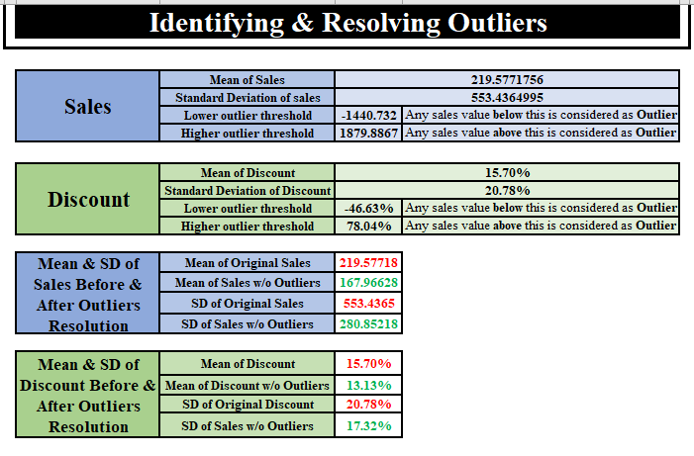
Identifying & RESOLVING OUTLIERS

Slide 5
The Lower and Upper threshold values for Discount and Sales were calculated as follows:
Lower Threshold (All values lesser than this value are outliers)
= Mean – 3*(Standard Deviation)
Upper Threshold (All values greater than this value are outliers)
= Mean + 3*(Standard Deviation)
Lower Threshold Values:
Sales: -1440.732
Discount : -46.63%
Upper Threshold Values:
1879.8867
78.04%

Slide 6
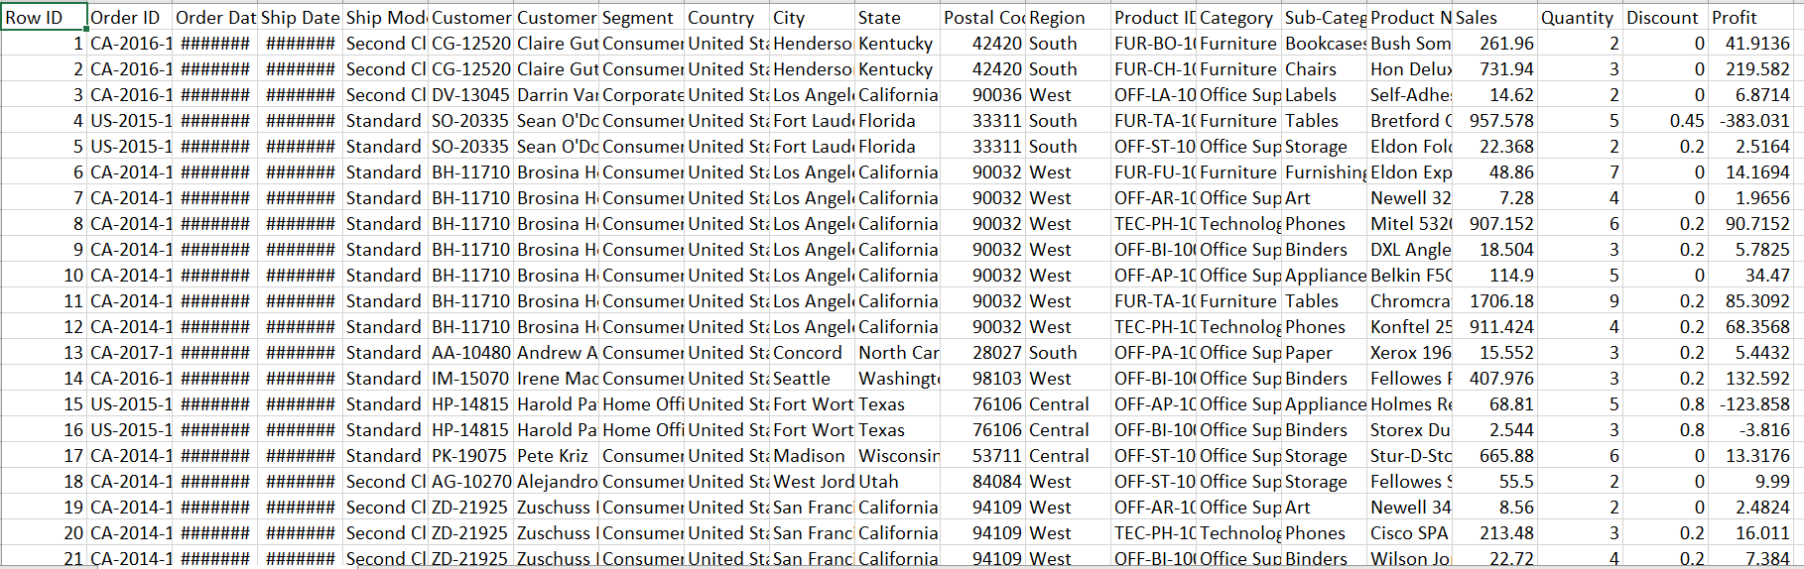
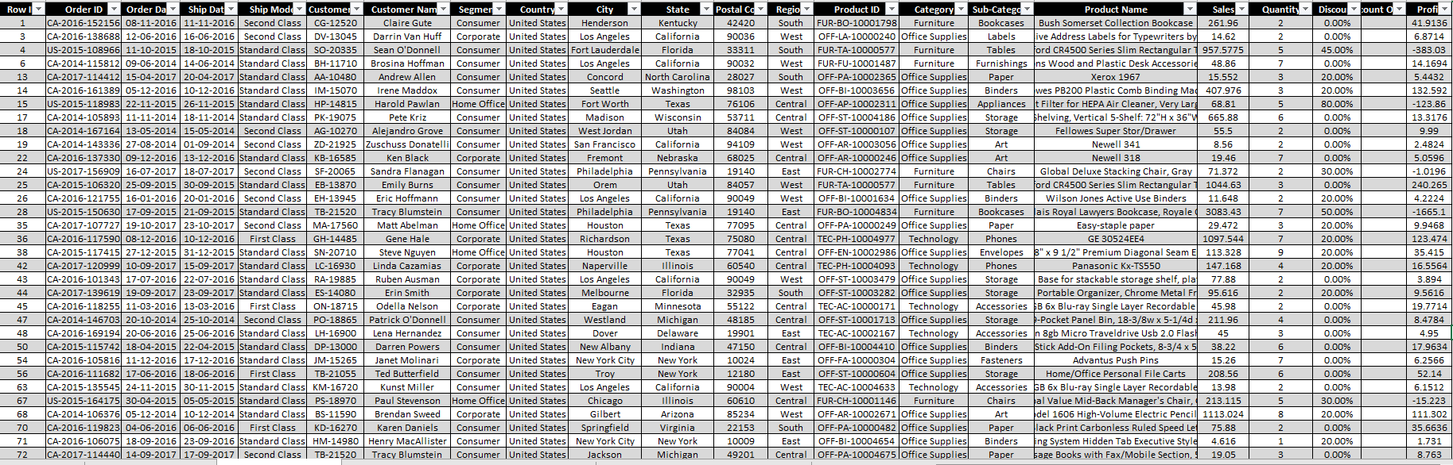
Before Cleaning & Formatting
After Cleaning & Formatting

Slide 7
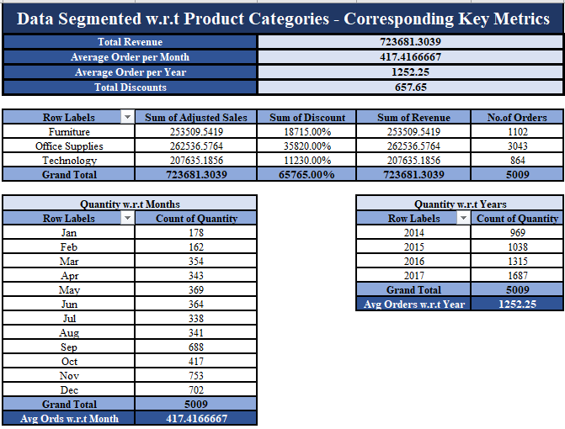
Key Metrics & Calculations
The Key Metrics: Total Revenue, Average Orders per Month, Average Orders per Year, & Total Discounts
Multiple Pivot Tables were generated: Quantity w.r.t Months, Quantity w.r.t Years, Key Metrics Overview

Slide 8
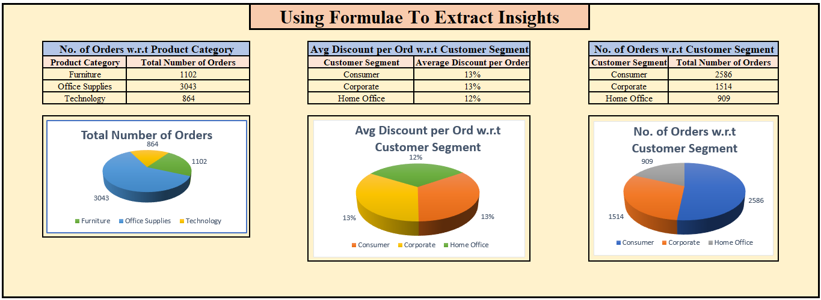
Formulae Used to Calculate:
COUNTIF [=COUNTIF(range, criteria)]
AVERAGEIF [=AVERAGEIF(range, criteria, [average_range])

Slide 9
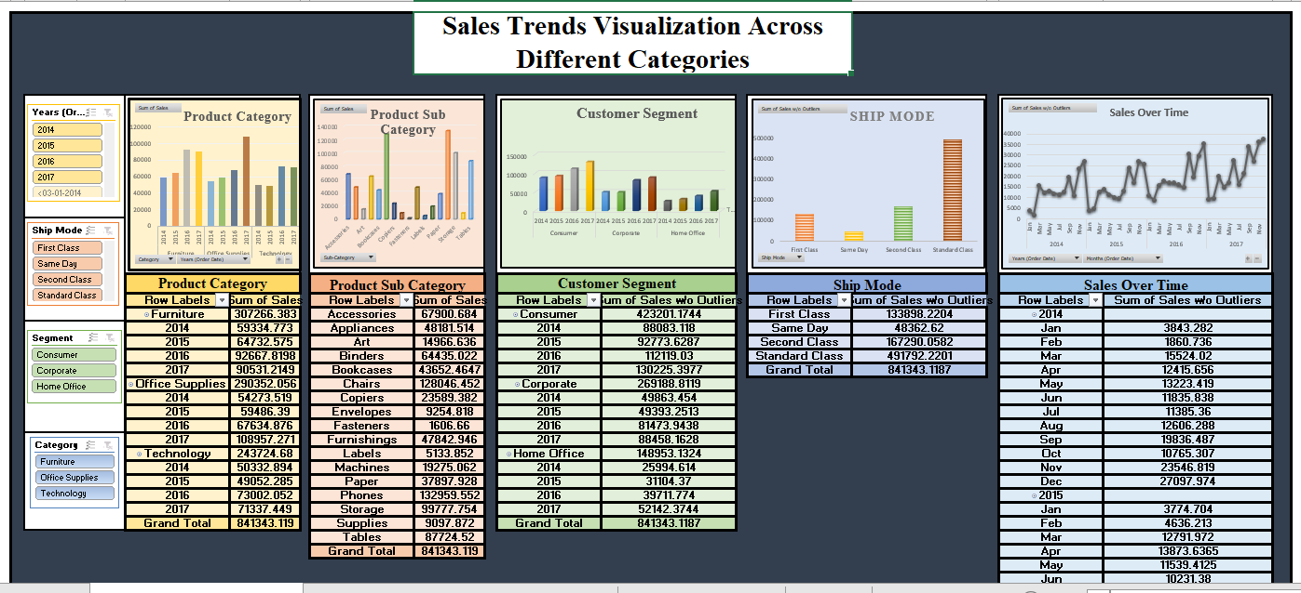
Pivot Tables & Charts
Pivot Tables were grouped by Product Category, Product Sub Category, Customer Segment, Ship Mode, Order Date (w.r.t Months, & Years)

Slide 10
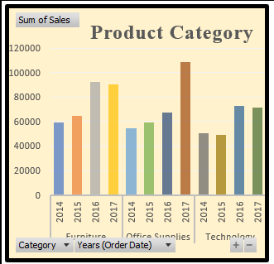
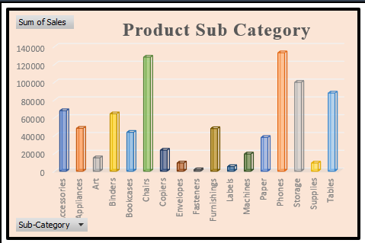
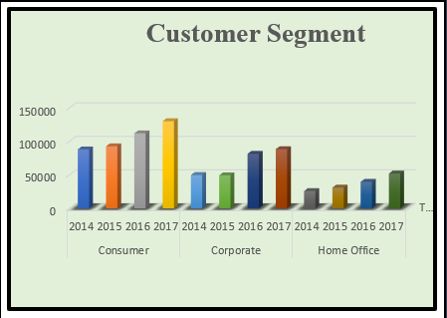
Product Category: Furniture has the max sales, followed by Office Supplies
Product Sub Category: Phones have the highest sales among all the sub categories of products
Customer Segment: Consumer Segment Contributes the highest sales among the Customer Segments

Slide 11
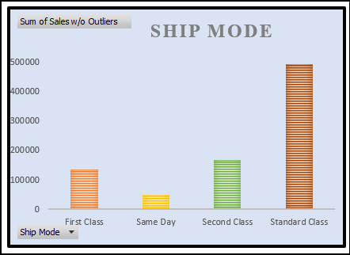
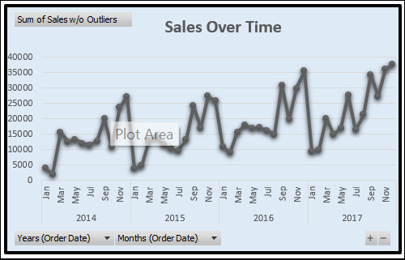
Ship Mode: Standard Class dominates sales, followed by Second Class
Order Date (w.r.t Year): 2017 has a record of highest sales followed by 2016
Order Date (w.r.t Quarters): Quarter 4, especially the Month December in every year have the maximum sales

Slide 12
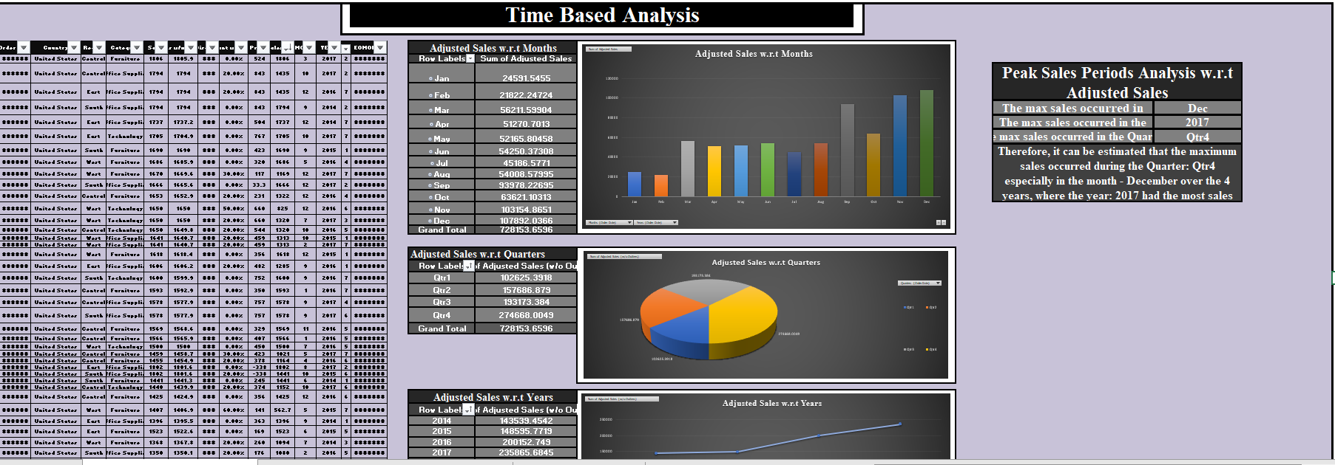
Time Based Analysis

Slide 13
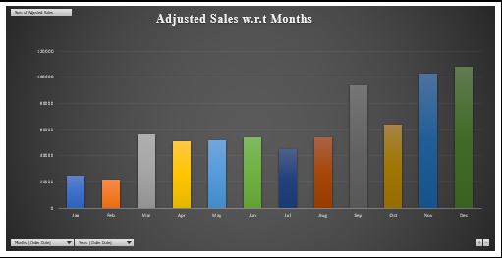
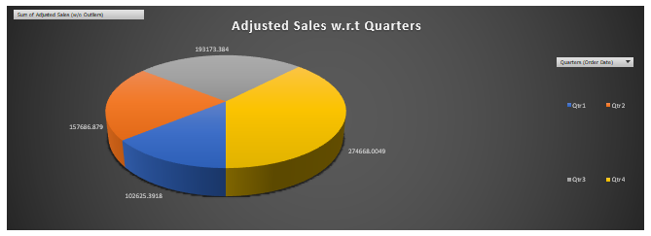
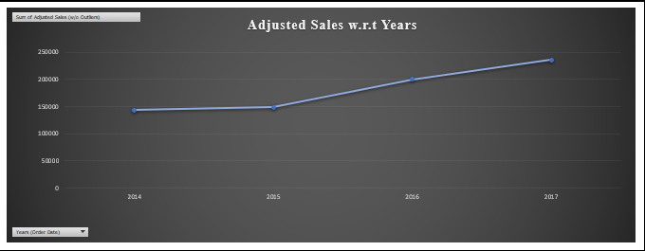
Adjusted Sales w.r.t Months (December)
Adjusted Sales w.r.t Quarters (Quarter 4)
Adjusted Sales w.r.t Years (2017)

Slide 14
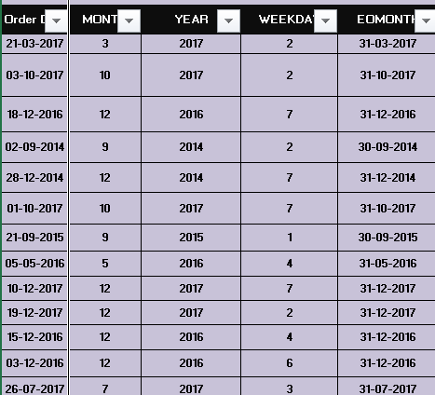
Formulae Used:
1. MONTH( )
2. YEAR( )
3. EOMONTH( )
4. WEEKDAY( )

Slide 15
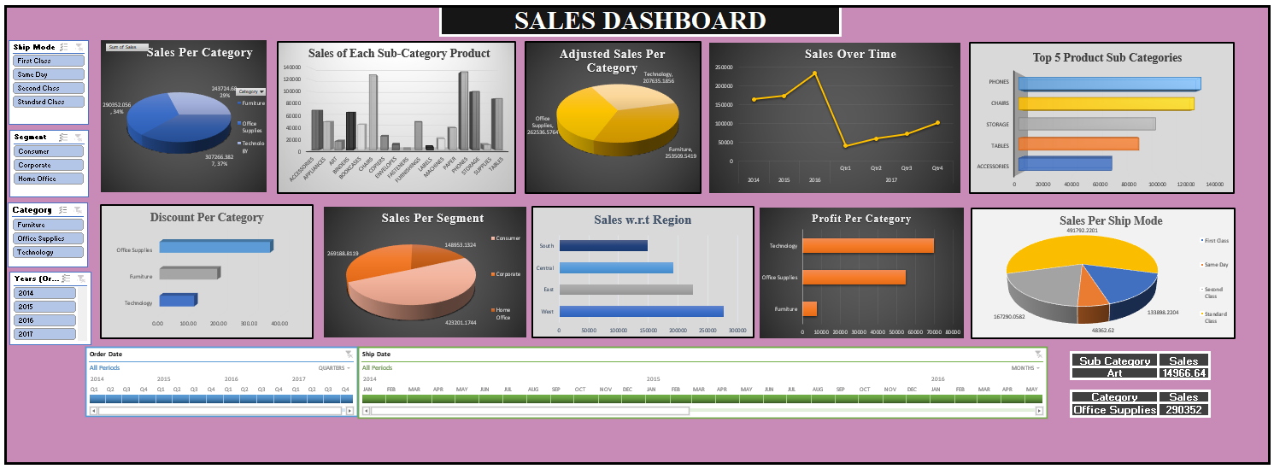
Dashboard Overview
A summary dashboard was created in Excel showing KPIs (Total Sales, Adjusted Sales, Profit, Discounts)

Slide 16
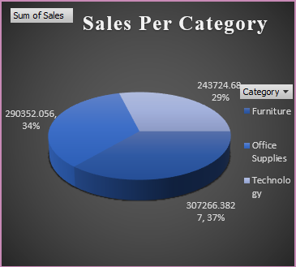
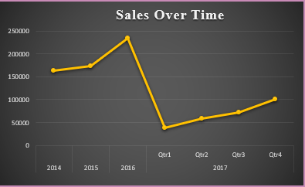
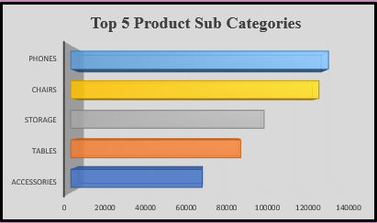
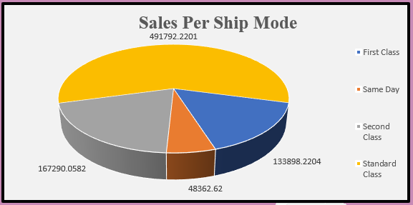
Category-wise performance (Furniture)
Ship Mode breakdown (Standard Class)
Sales Performance Over Time
Top 5 Product Sub-Categories

Slide 17
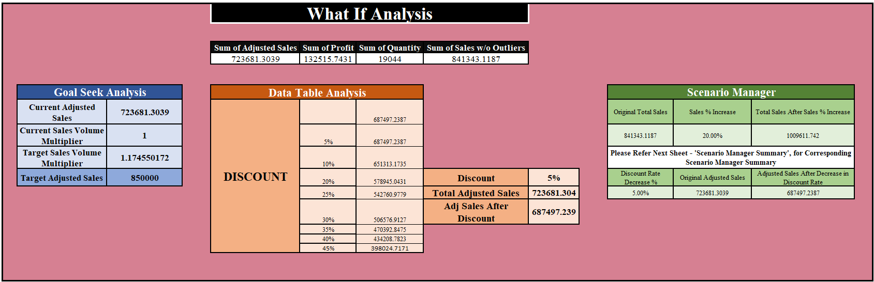
What-If Analysis
Types of Analysis Implemented: Goal-Seek Analysis, Data Table Analysis, Scenario Manager

Slide 18
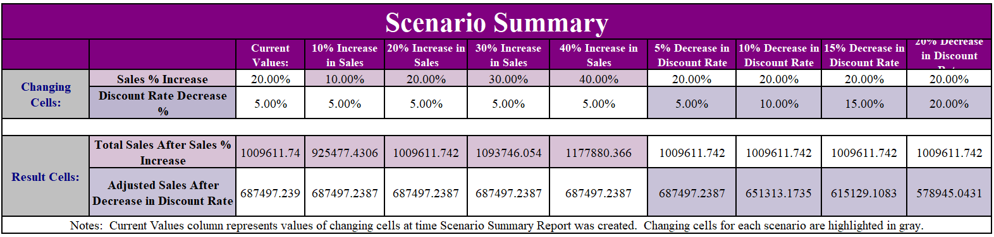
Scenario Summary:
Various scenarios were created for the Sales Percentage Increase & Discount Rate Decrease to see their impact on Total Sales and Adjusted Sales respectively

Slide 19
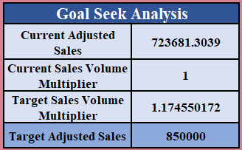
Goal Seek Analysis was implemented to reach a Target Adjusted Sales of 850000 (original = 723681.3039) by changing the Sales Volume Multiplier

Slide 20
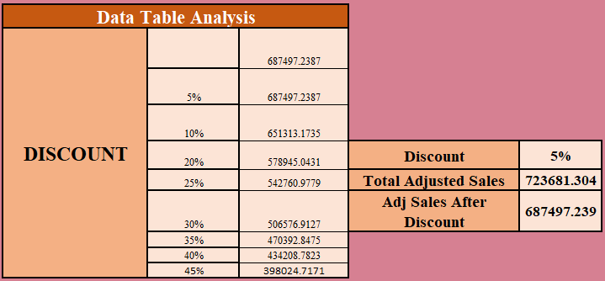
Data Table Analysis was used to determine Total Adjusted Sales after various Discounts were applied to it(Original Total Adjusted Sales = 723681.304)
Where, the 5% discount applied on Total Adjusted Sales was taken as reference to do so

Slide 21
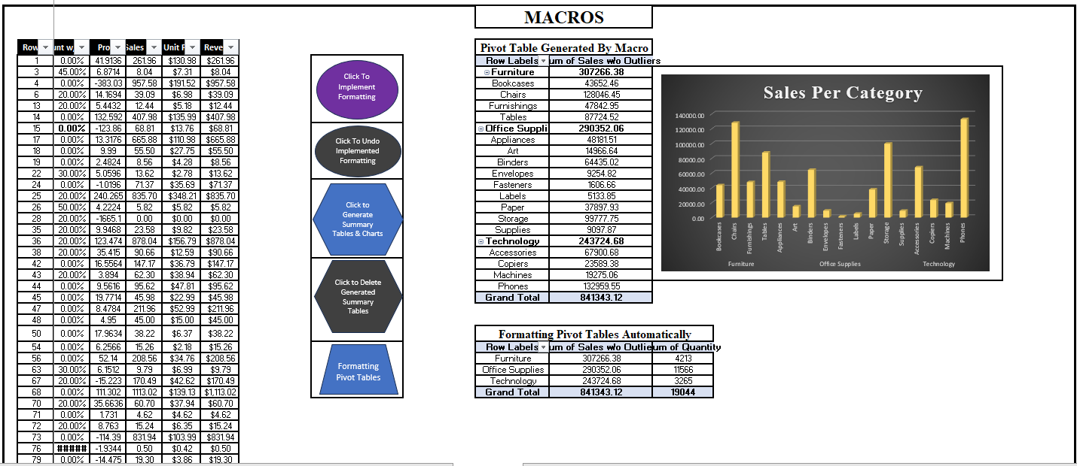
Macros & Automation

Slide 22
5 Macros were created:
To implement Formatting for a table in the worksheet
To Undo the Formatting implemented on a table in the worksheet
To Generate Summary Tables & Charts
To Delete Generated Summary Tables
To Pivot Tables & Apply Formatting Automatically

Slide 23
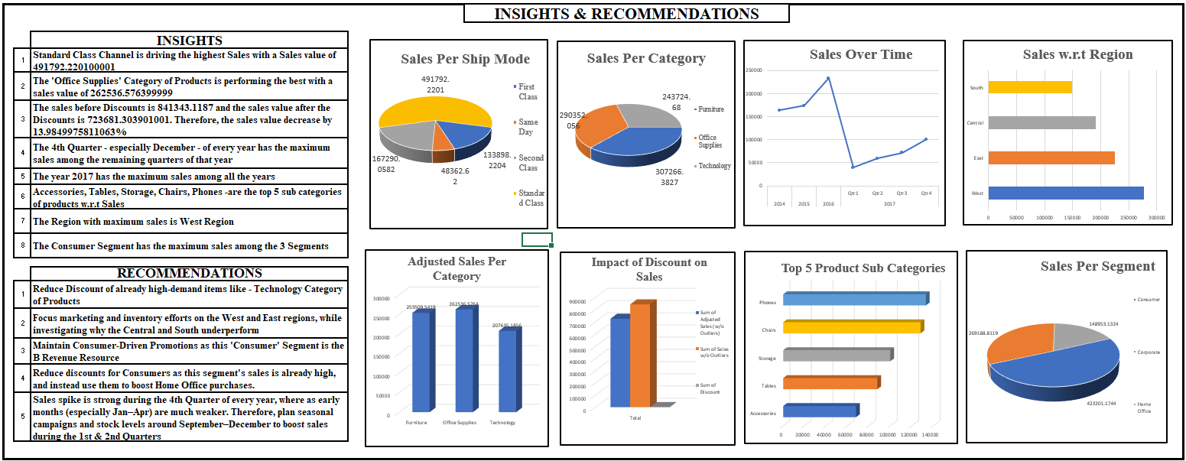
Insights & Recommendations

Slide 24
Insights:
Standard Class Channel is driving the highest sales with a Sales value of 491792.220100001
The ‘Office Supplies’ Category of Products is performing the best with a sales of 262536.576399999
The Sales before Discount is 841343.1187 and the Sales value after the Discounts is 723681.303901001. Therefore, the sales value decreased by ~14%
The 4th Quarter – especially December – of every year has the most sales among the remaining quarters of that year
The year 2017 has the maximum sales among all the 4 years
Phones, Chairs, Storage, Tables, & Accessories are the top 5 Sub-Categories w.r.t Sales
The West Region has the maximum Sales
The Consumer Segment has the highest sales among the 3 segments

Slide 25
Recommendations:
Reduce Discount of already high-demand items like - Technology Category of Products
Focus marketing and inventory efforts on the West and East regions, while investigating why the Central and South underperform
Maintain Consumer-Driven Promotions as this 'Consumer' Segment is the B Revenue Resource
Reduce discounts for Consumers as this segment's sales is already high, and instead use them to boost Home Office purchases.
Sales spike is strong during the 4th Quarter of every year, where as early months (especially Jan–Apr) are much weaker. Therefore, plan seasonal campaigns and stock levels around September–December to boost sales during the 1st & 2nd Quarters

Slide 26
Conclusion & Next Steps
The analysis revealed where revenue is strongest, which products and segments drive profitability, and how discounts affect net sales
Strategic actions such as discount optimization, regional targeting, and seasonal campaigns can boost both sales and profit.
Next Steps:
• Forecast future sales trends using historical patterns
• Explore customer-level profitability and retention strategies
• Extend dashboard automation for real-time reporting.

Slide 27
THANK YOU !

